Slide 1
VMware Desktop Hypervisors
Lecturer: Ngo Huy Bien
Software Engineering Department
Faculty of Information Technology
University of Science
Ho Chi Minh City, Vietnam
nhbien@fit.hcmus.edu.vn

Slide 2

Objectives

Slide 3

Contents
VMware Workstation Pro
VMware Fusion Pro

Slide 4

References
VMware (2022). vSphere Networking.

Slide 5
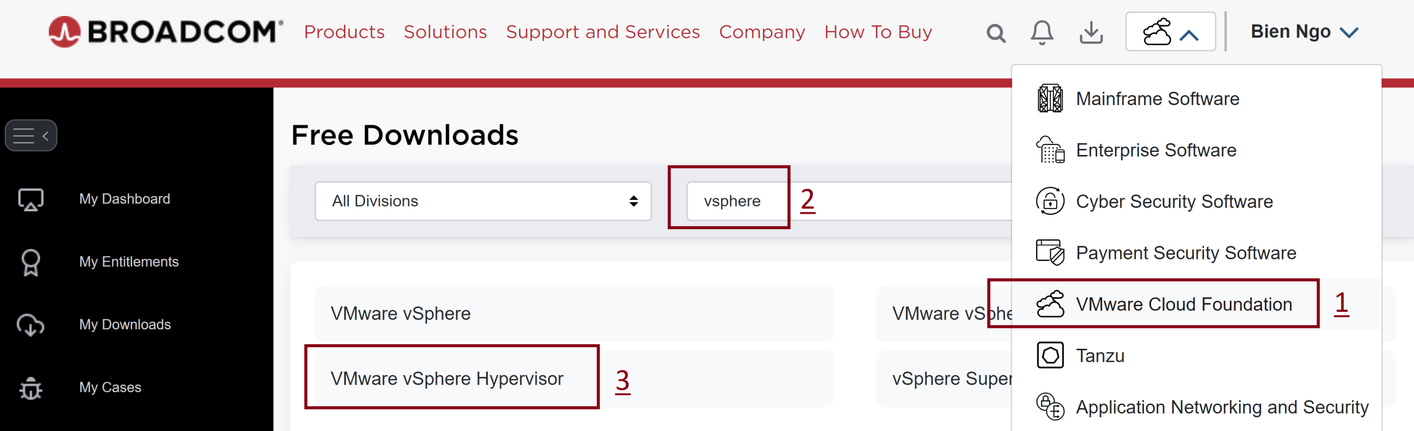
1. Register a Broadcom Account
https://support.broadcom.com/group/ecx/free-downloads
Search for "workstation" or "fusion".

Slide 6
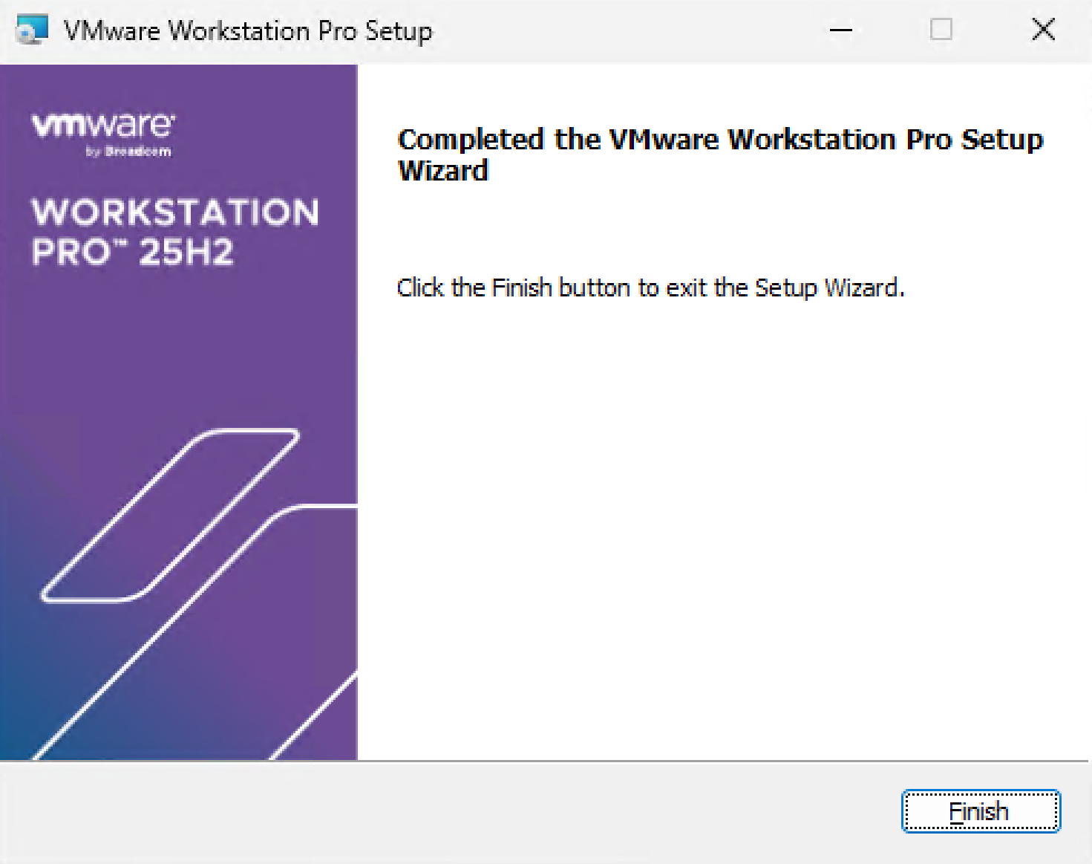
2. Install VMware Workstation Pro on Windows
Download VMware Workstation Pro.
Install VMware Workstation Pro.
Purpose: To install ESXi on a VM.
Use only Windows version for both VMware Workstation Pro and ESXi.

Slide 7
3. Check Physical and Logical Cores
# Check the number of physical and logical cores on Windows using PowerShell:
Get-CimInstance Win32_Processor | Select-Object NumberOfCores, NumberOfLogicalProcessors

Slide 8


Slide 9
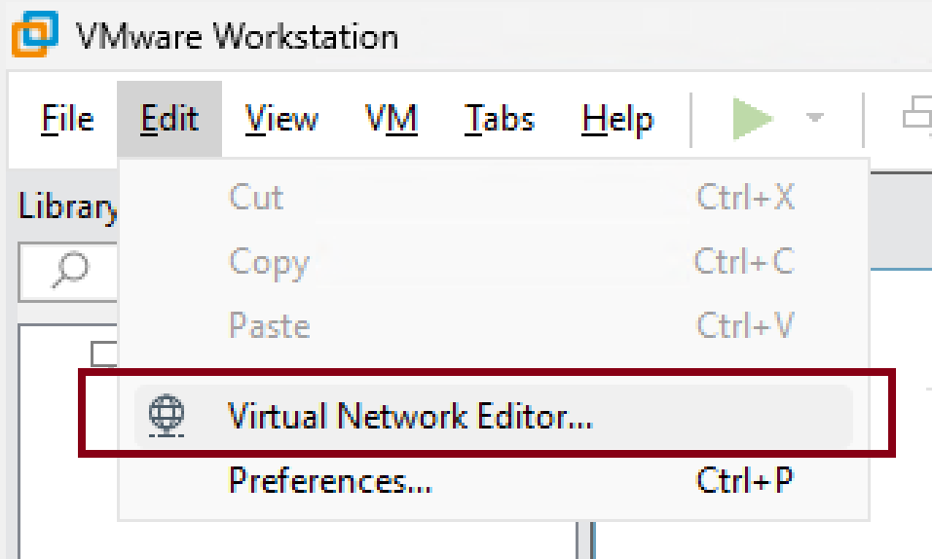
1. Create a Virtual Network

Slide 10
2. Create a Virtual Machine
Hardware compatibility: ESXi 7.0.
Installer disk image file: Use 7.0 version ISO (e.g. VMware-VMvisor-Installer-7.0U3f-20036589.x86_64.iso)
Guest operating system: VMware ESX.
Virtual machine name: VMware ESXi 7.
Number of processors: 2.
Memory for this virtual machine: 6144MB.
Network connection: NAT
Store virtual disk as a single file. Do NOT change the default size (i.e. 142Gb). The change affects ESXi VM storage.

Slide 11
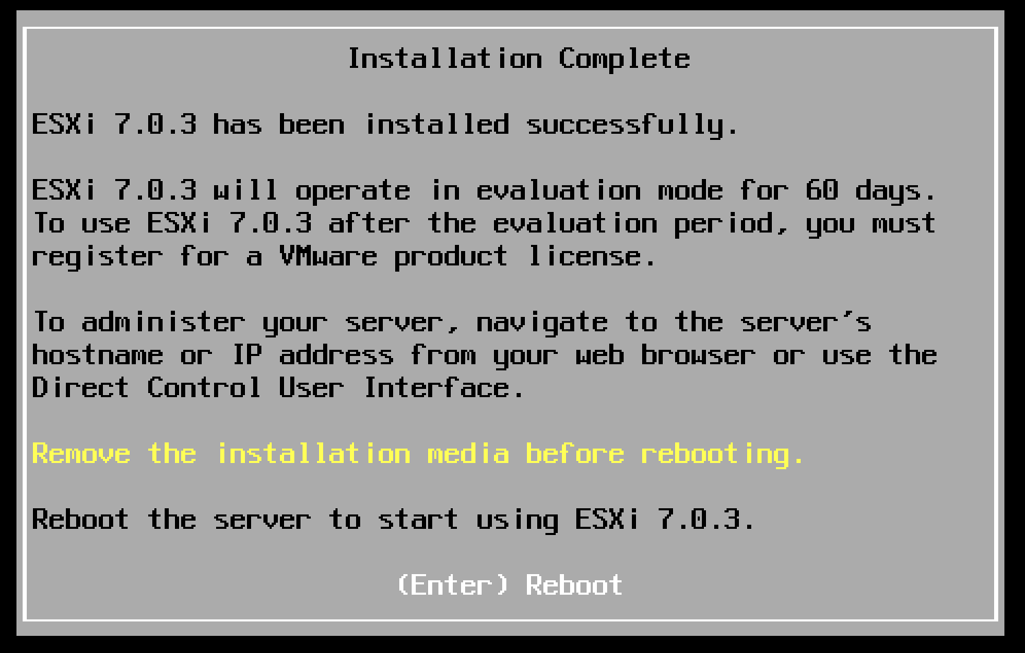
3. Install ESXi
Confirm storage: 142GB. Enter root password. Confirm disk repartition.
Do NOT click "I Finished Installing". It may affect the VM installation.

Slide 12
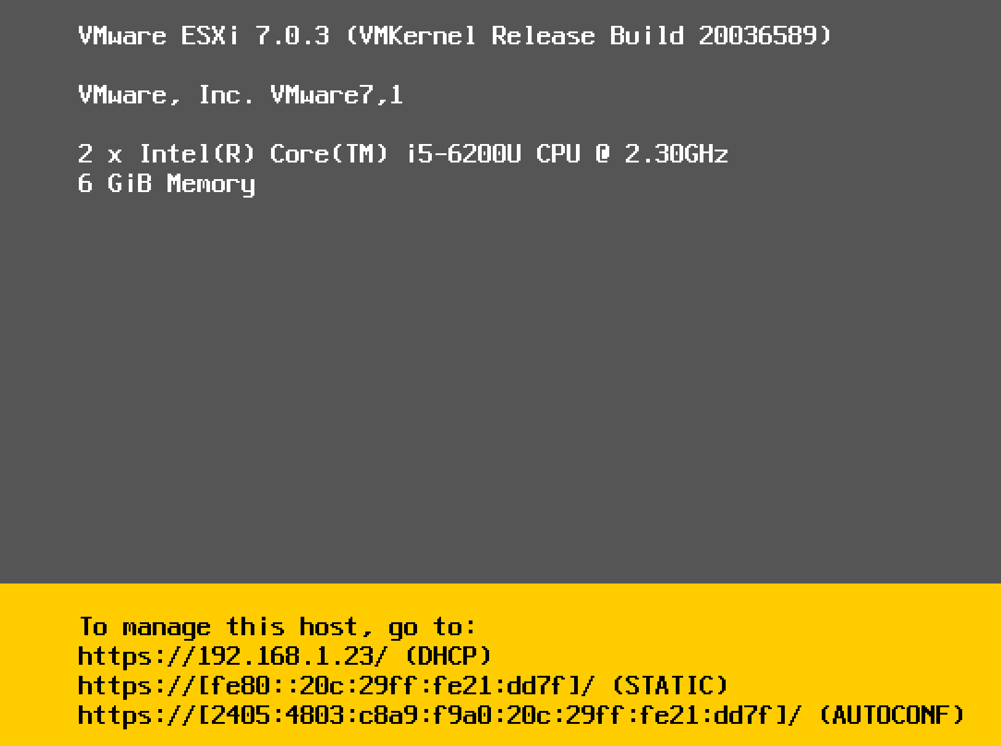
4. Retrieve Host Information

Slide 13
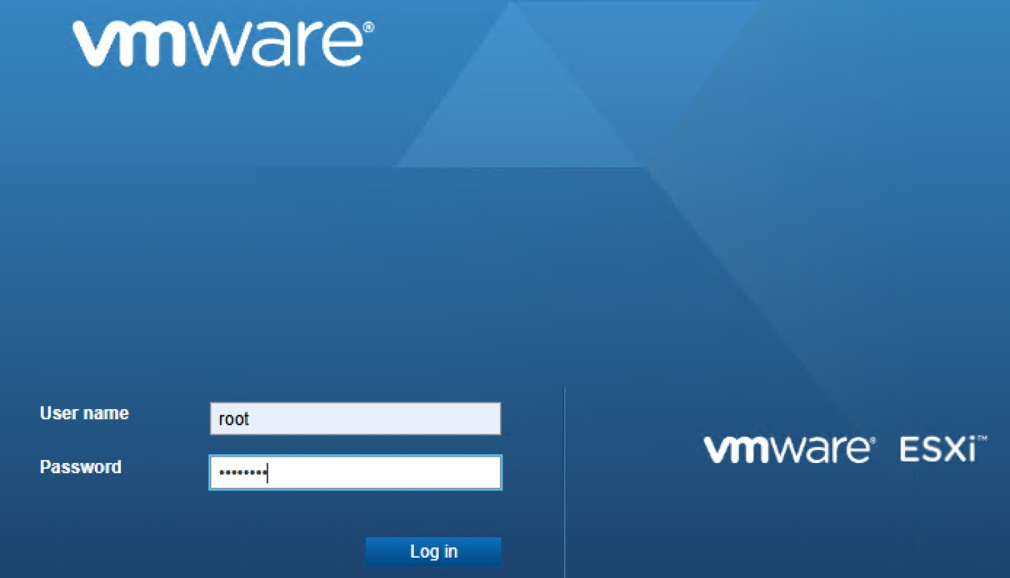
5. Log in ESXi Host
https://192.168.1.23

Slide 15
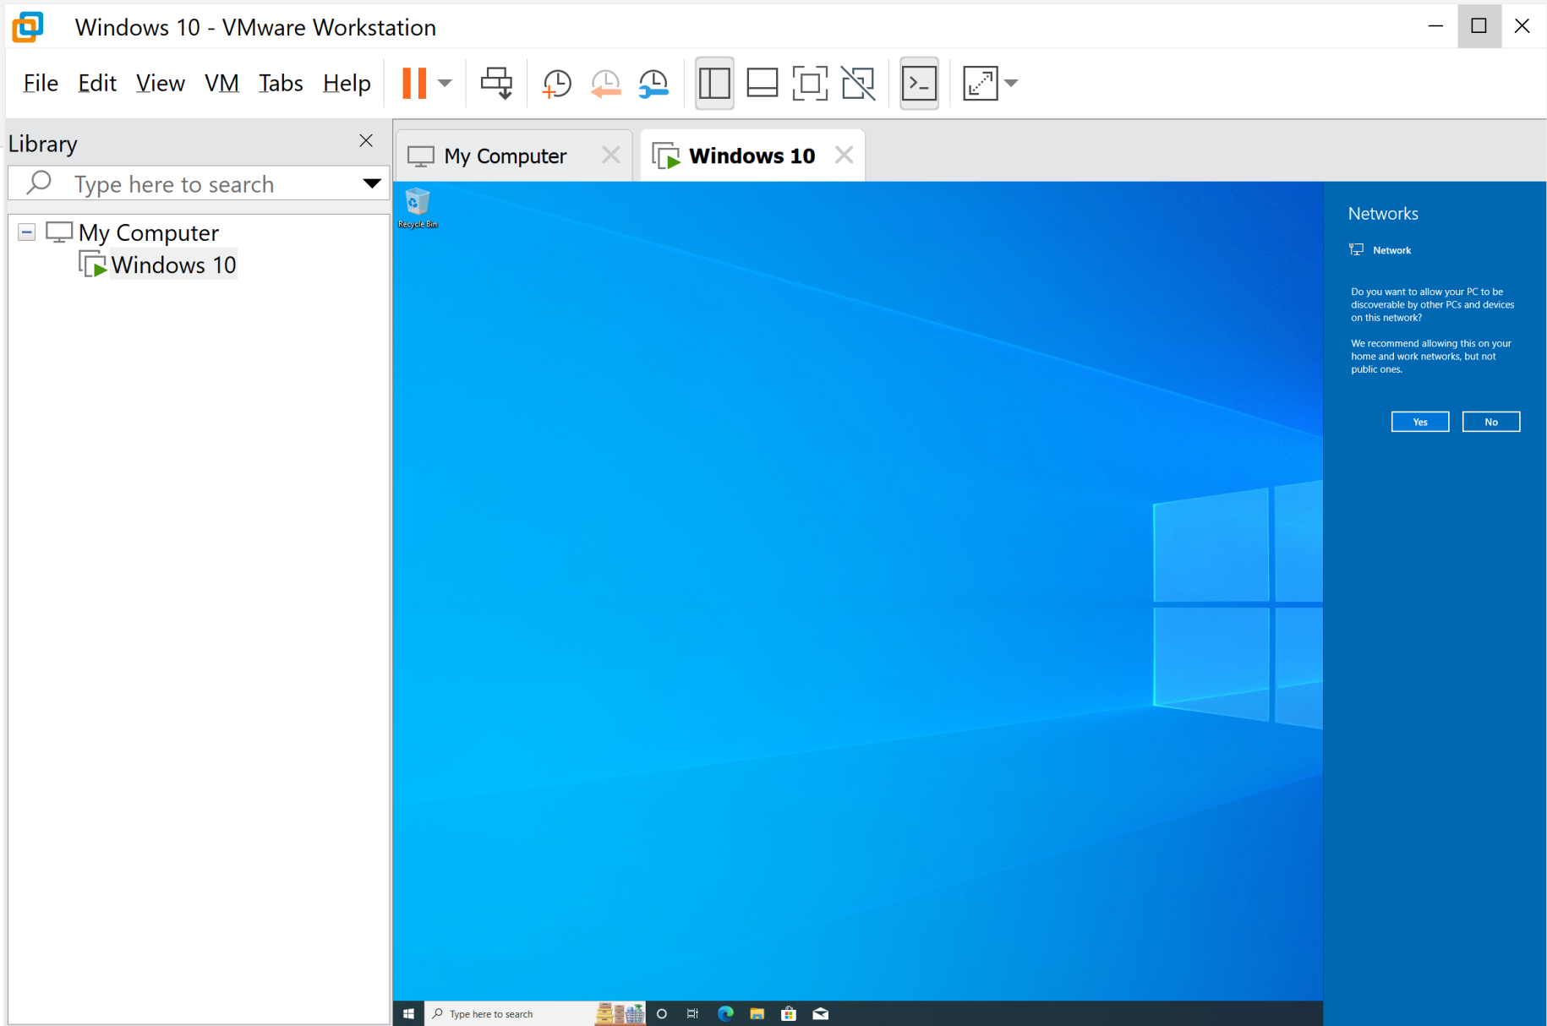
1. Enable VM PC Discovery

Slide 16
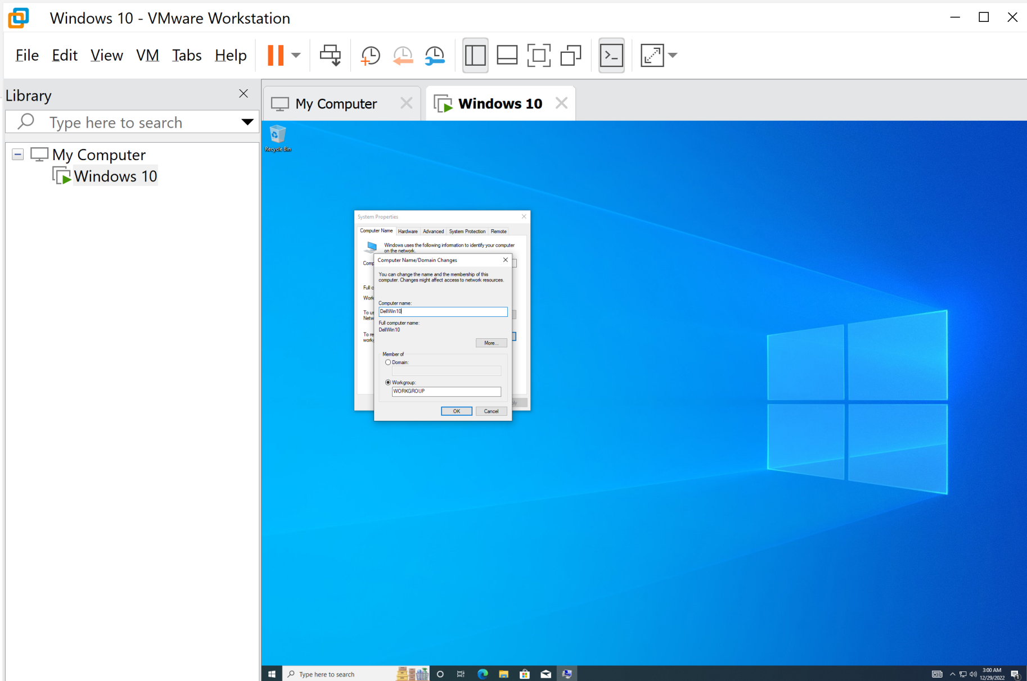
2. Change VM Computer Name

Slide 17
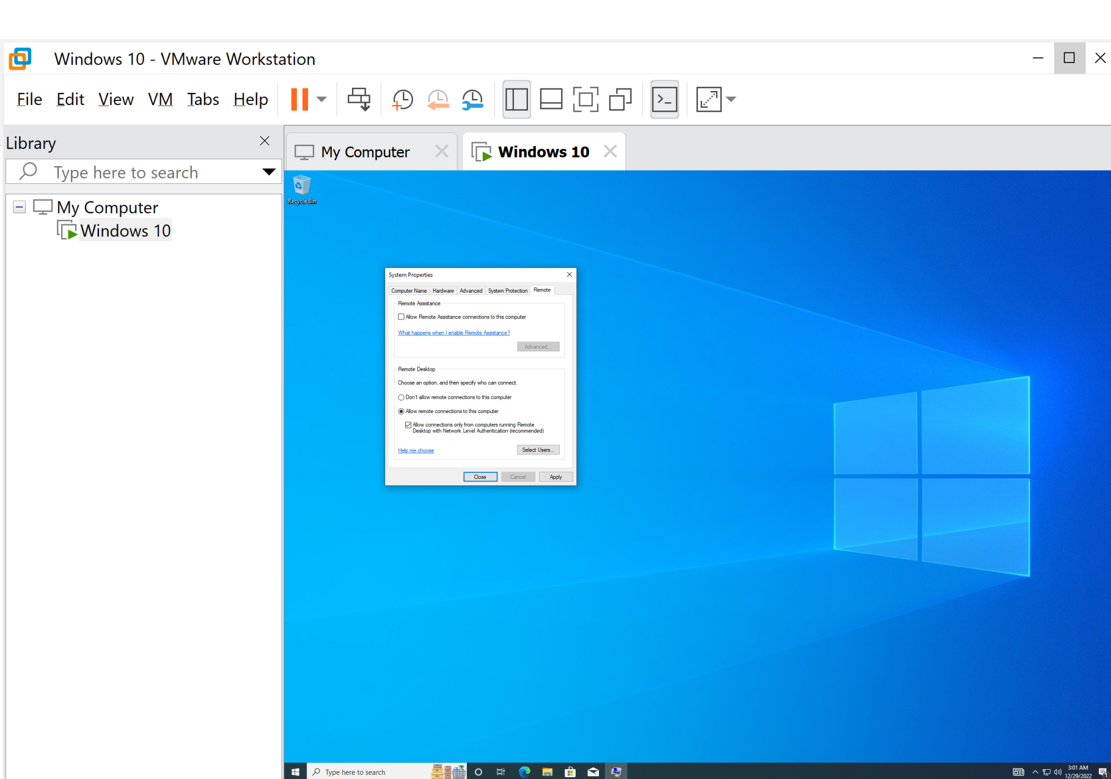
3. Enable RDC to VM

Slide 19
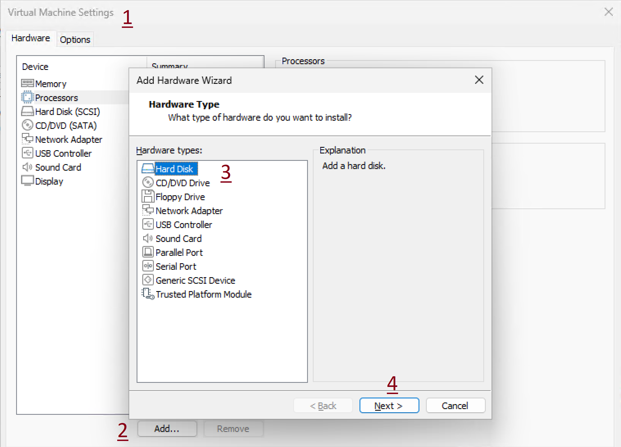
1. Add New Disk to Hypervisor

Slide 20
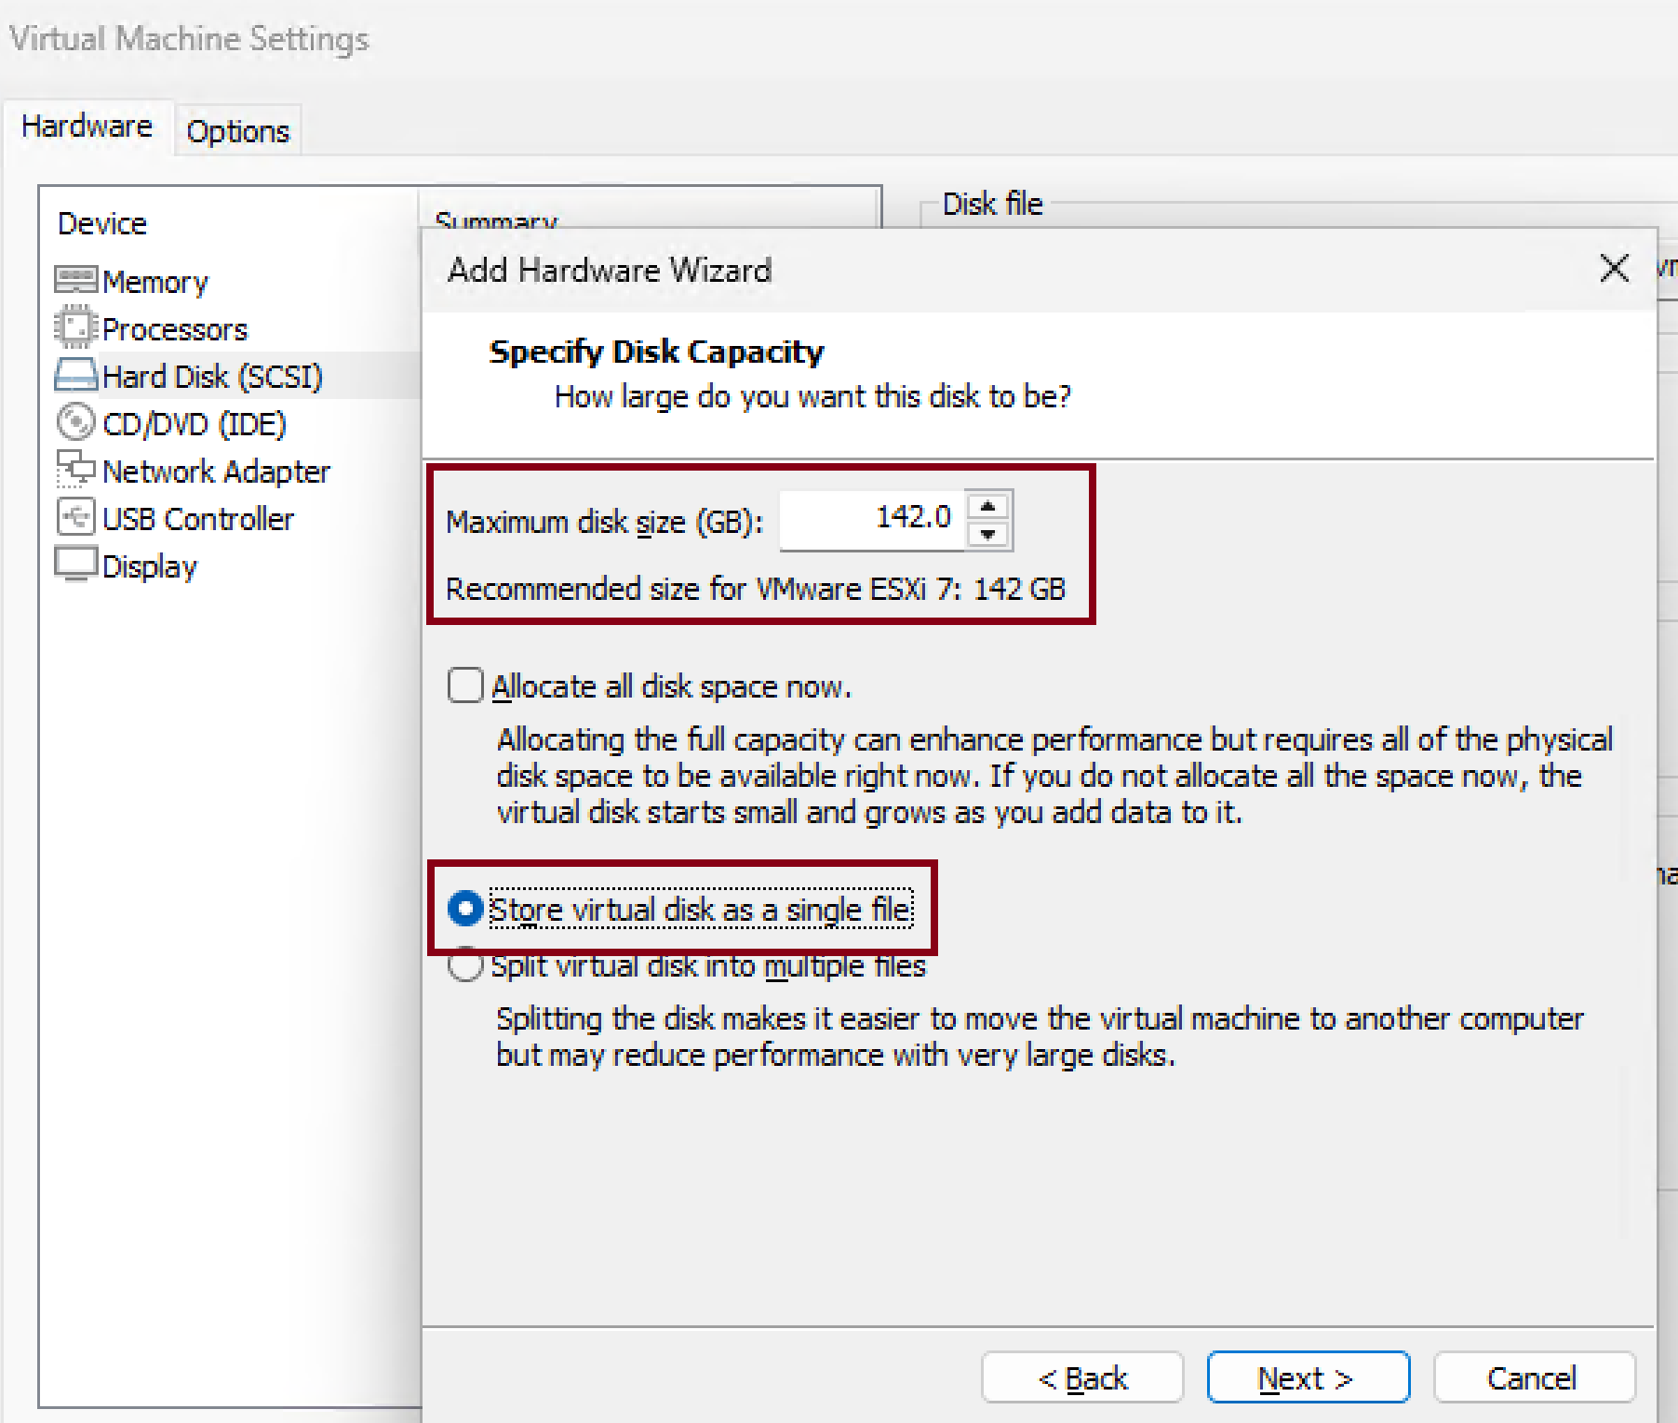
2. Specify Disk Capacity
Reboot the server to recognize the new disk.

Slide 21
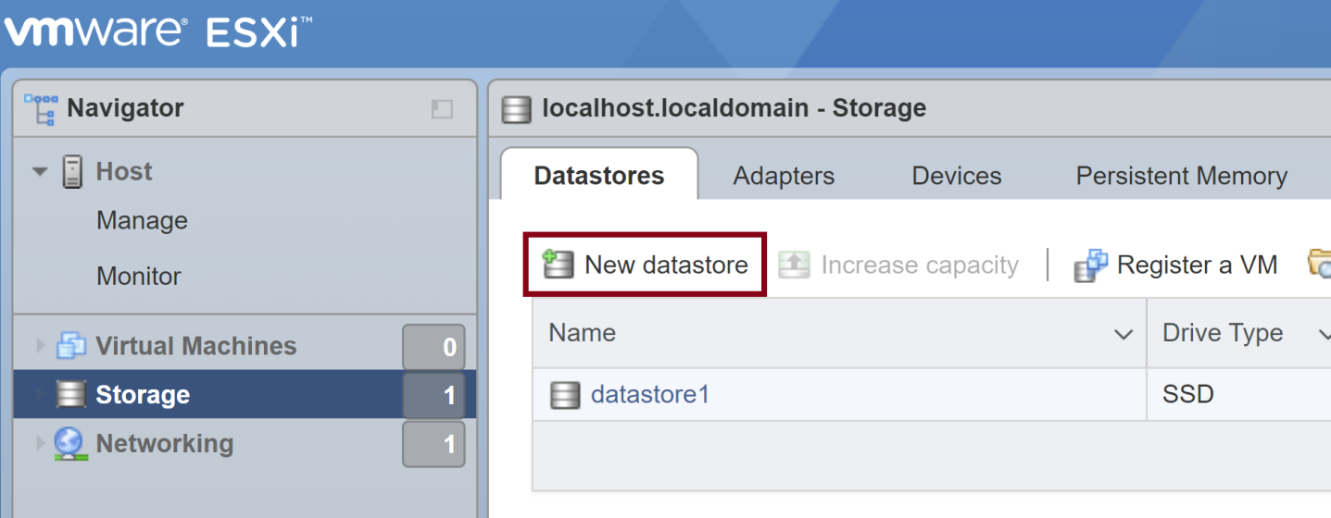
3. Add New datastore

Slide 22
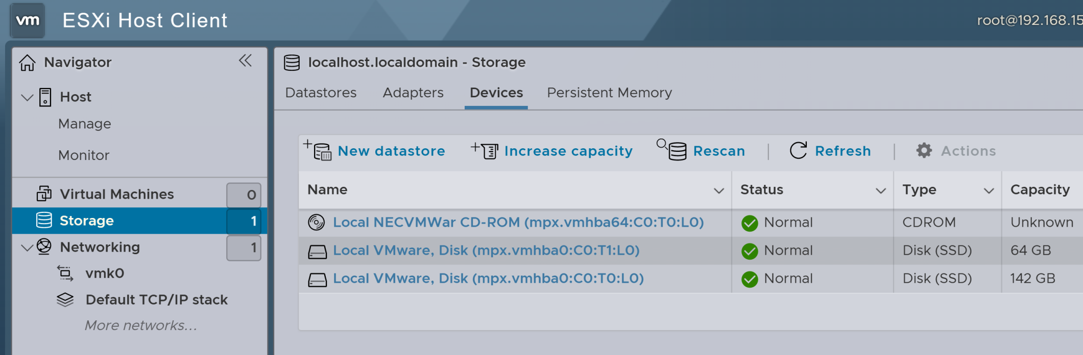
4. Review all Disks

Slide 23
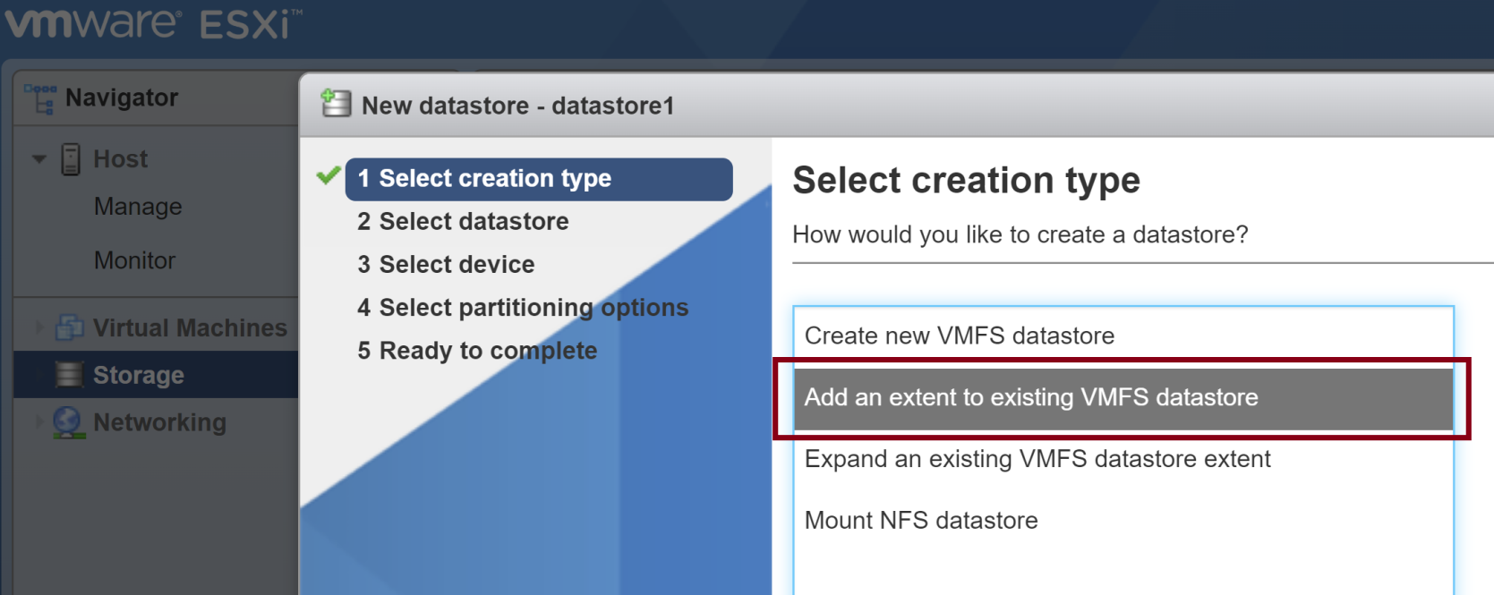
5. Extend datastore

Slide 24
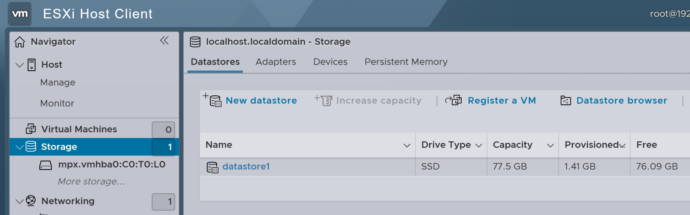
6. Review Extended datastore

Slide 25
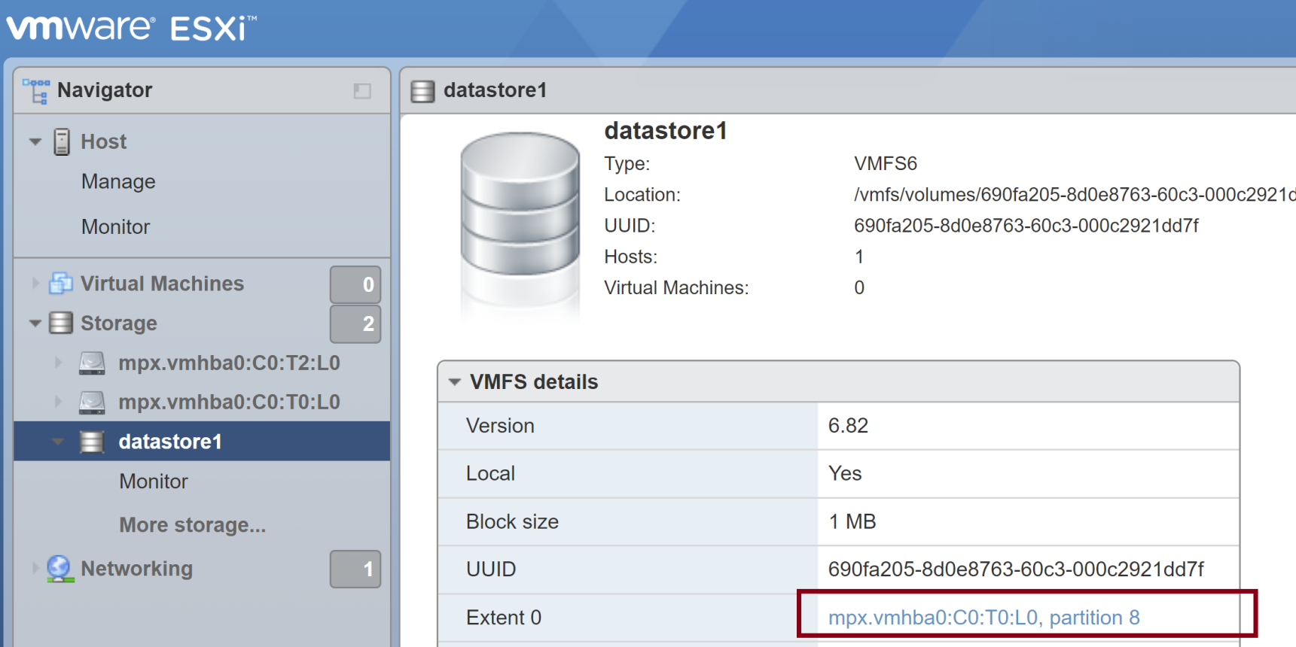
7. Open Disk Partitions

Slide 26
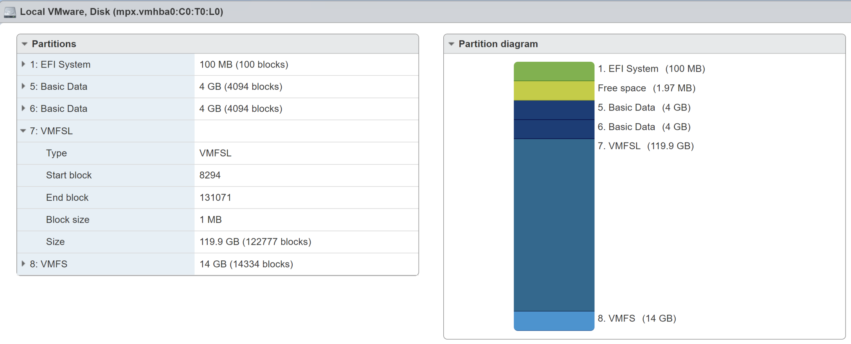
8. Review Disk Partitions

Slide 27
VMware File System Layer
VMFSL stands for VMware File System Layer.
It is an internal VMkernel subsystem in VMware ESXi that manages file systems, especially VMFS (VMware File System) and NFS datastores.
VMware ESXi automatically allocates roughly 120 GB of an installation disk to the VMFS-L (VMFSL or ESX-OSData) partition, which is a system-level file system used to store configuration data, logs, swap, core dumps, and runtime state, ensuring reliability and performance for services like vSAN and HA by design.

Slide 29
Physical Network [1]
A network of physical machines that are connected so that they can send data to and receive data from each other.
VMware ESXi runs on a physical machine.

Slide 30
Virtual Network
A network of virtual machines running on a physical machine that are connected logically to each other so that they can send data to and receive data from each other.
Virtual machines can be connected to the virtual networks that you create when you add a network.

Slide 31
Opaque Network
An opaque network is a network created and managed by a separate entity outside of vSphere.
For example, logical networks that are created and managed by VMware NSX.

Slide 32
Physical Ethernet Switch
A physical ethernet switch manages network traffic between machines on the physical network.
A switch has multiple ports, each of which can be connected to a single machine or another switch on the network.
Each port can be configured to behave in certain ways depending on the needs of the machine connected to it.
The switch learns which hosts are connected to which of its ports and uses that information to forward traffic to the correct physical machines.
Switches are the core of a physical network.
Multiple switches can be connected together to form larger networks.

Slide 33
vSphere Standard Switch
It works much like a physical Ethernet switch.
It detects which virtual machines are logically connected to each of its virtual ports and uses that information to forward traffic to the correct virtual machines.
A vSphere standard switch can be connected to physical switches by using physical Ethernet adapters, also referred to as uplink adapters, to join virtual networks with physical networks.
This type of connection is similar to connecting physical switches together to create a larger network.
Even though a vSphere standard switch works much like a physical switch, it does not have some of the advanced functionality of a physical switch.

Slide 34
Standard Port Group
Network services connect to standard switches through port groups.
Port groups define how a connection is made through the switch to the network.
Typically, a single standard switch is associated with one or more port groups.
A port group specifies port configuration options such as bandwidth limitations and VLAN tagging policies for each member port.

Slide 35
VLAN
VLAN enable a single physical LAN segment to be further segmented so that groups of ports are isolated from one another as if they were on physically different segments.
The standard is 802.1Q.

Slide 36
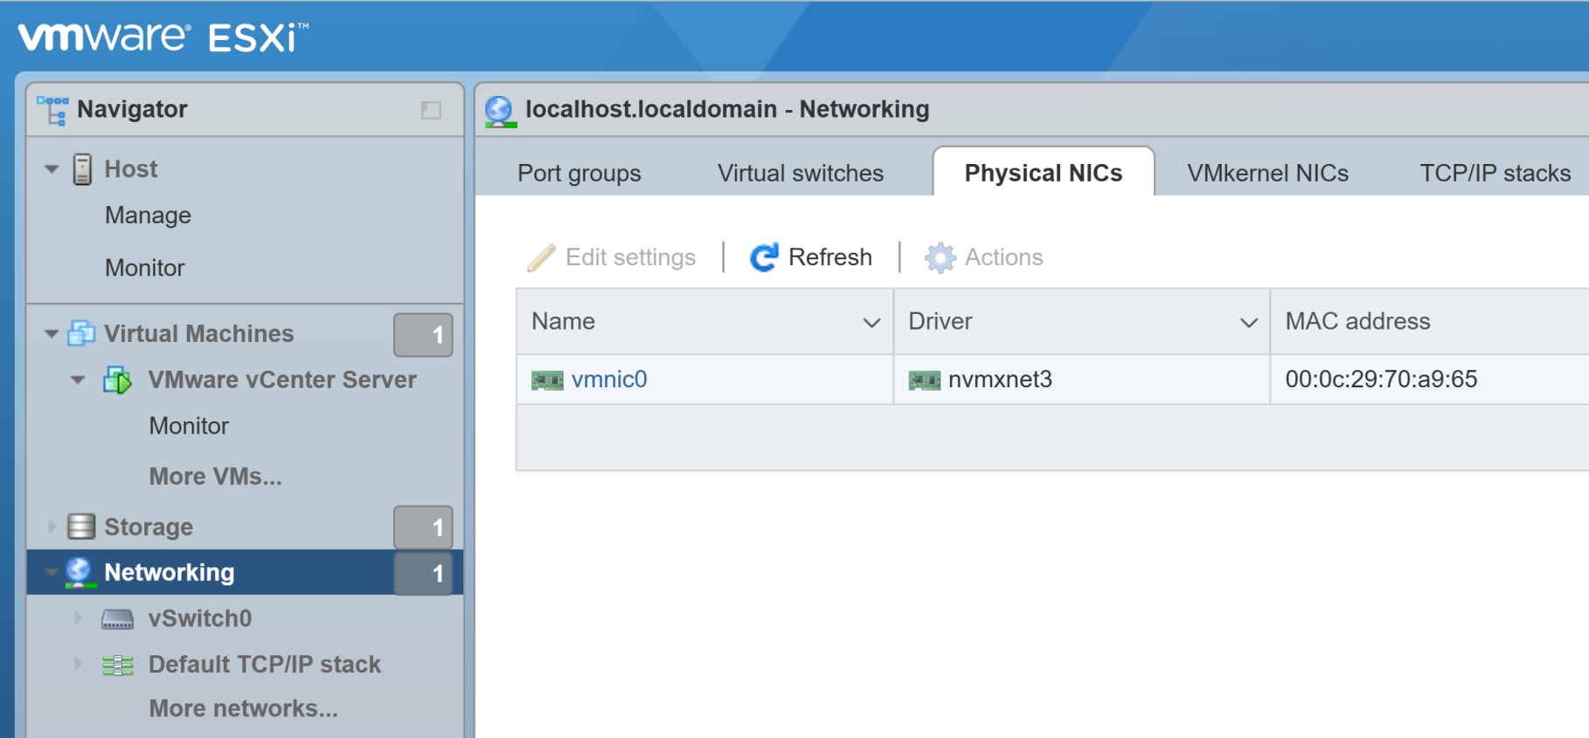
1. Review Physical NICs

Slide 37
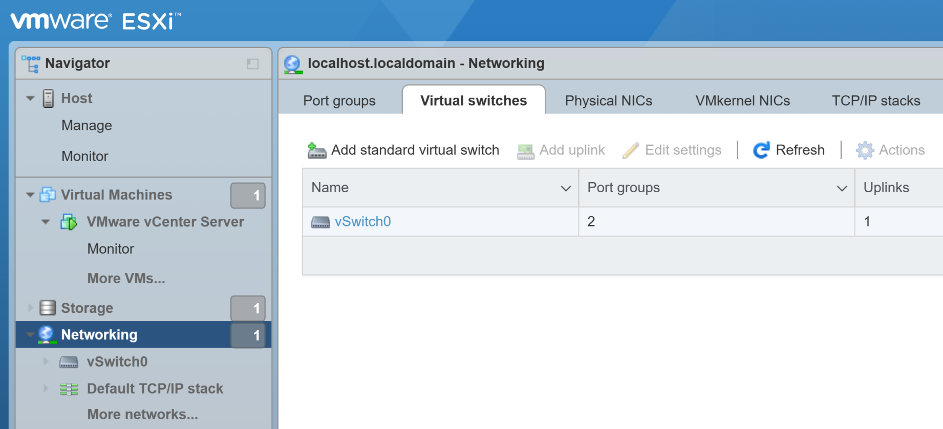
2. Review Virtual Switches
Standard Switch A software-based switch that resides in the VMkernel and provides traffic management for virtual machines.
Users must manage Standard Switches independently on each ESXi host.

Slide 38
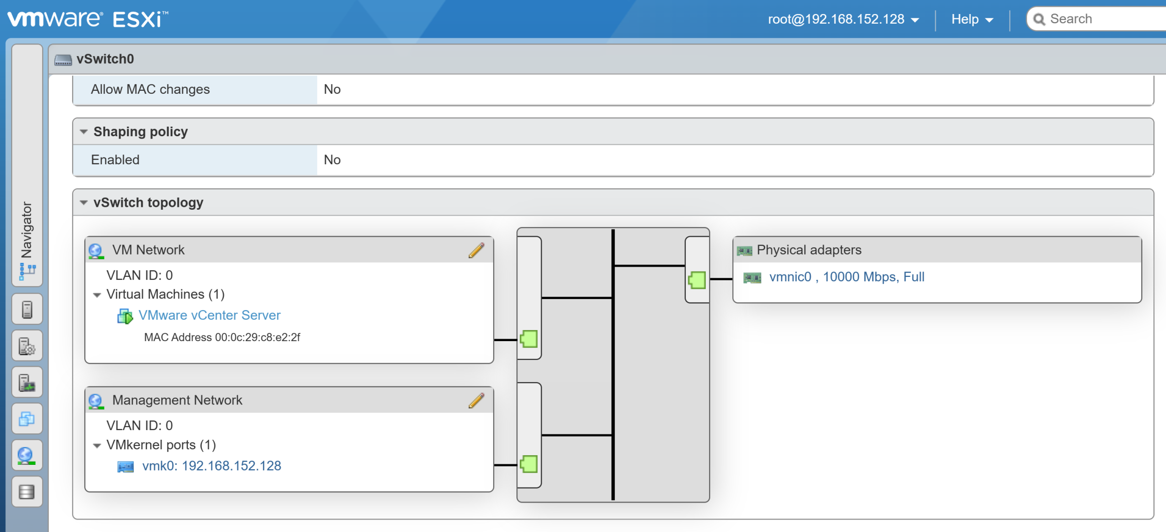
3. Review Switch Topology

Slide 39
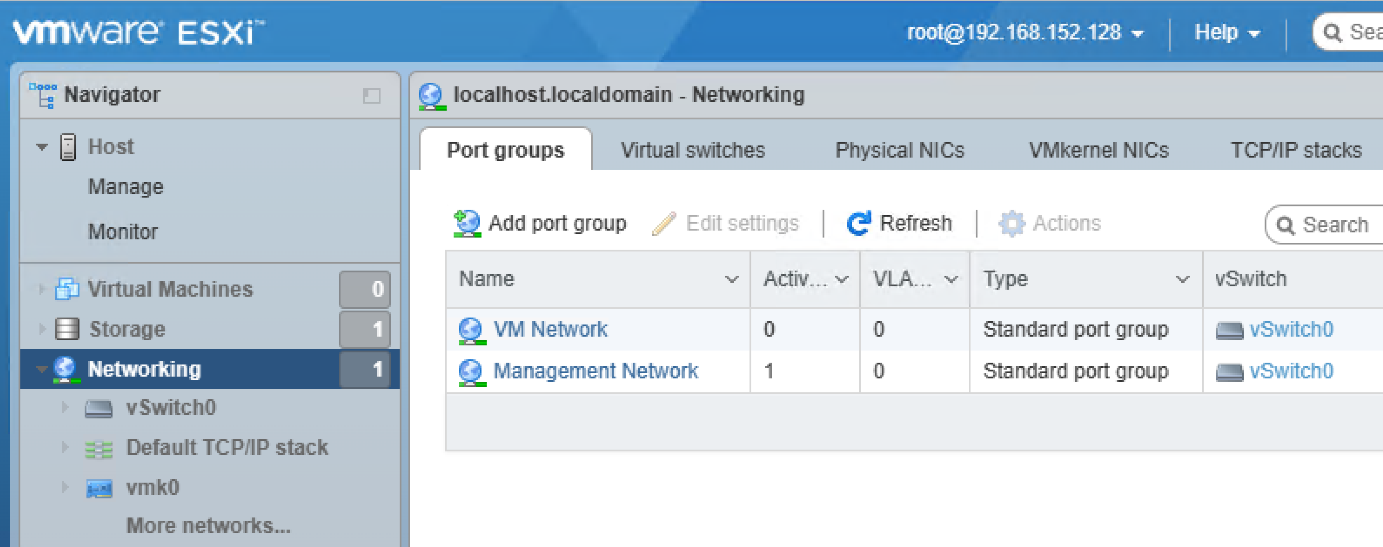
4. Review Port Groups

Slide 40
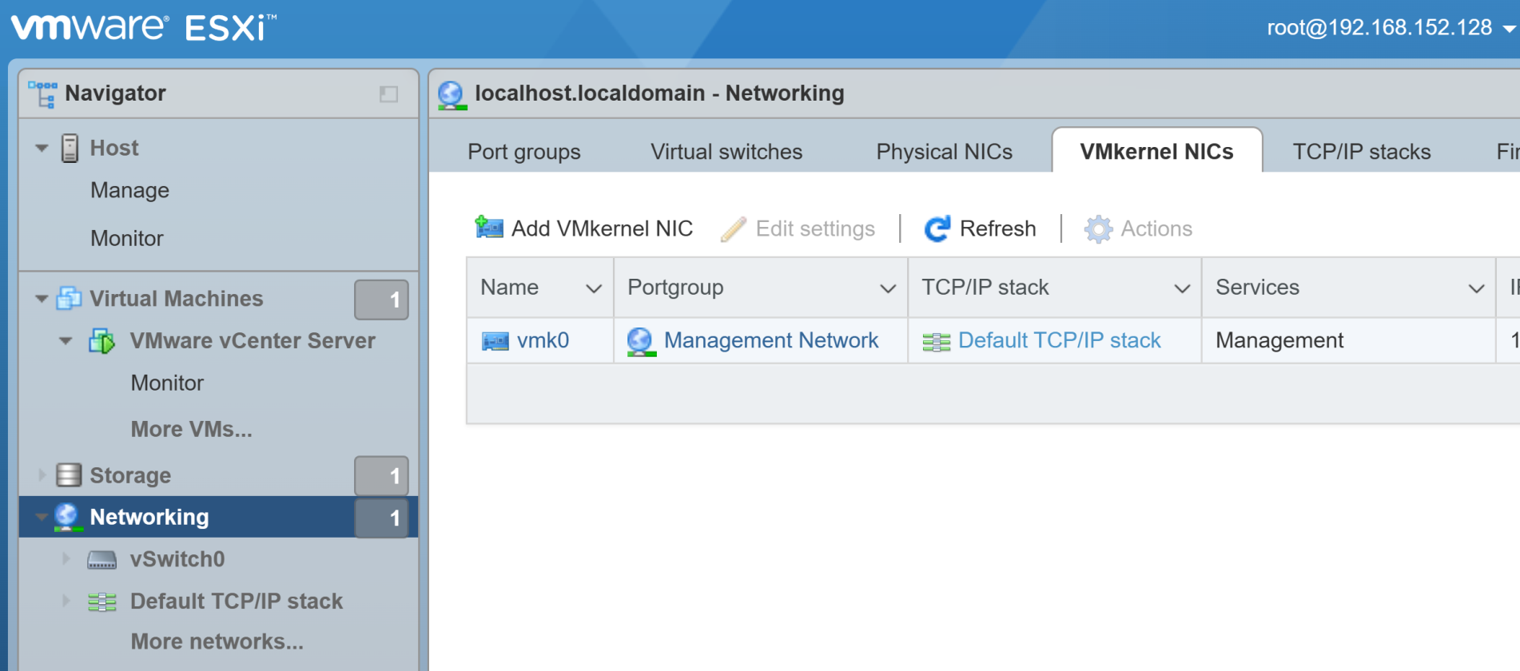
5. Review VMkernel NICs

Slide 41
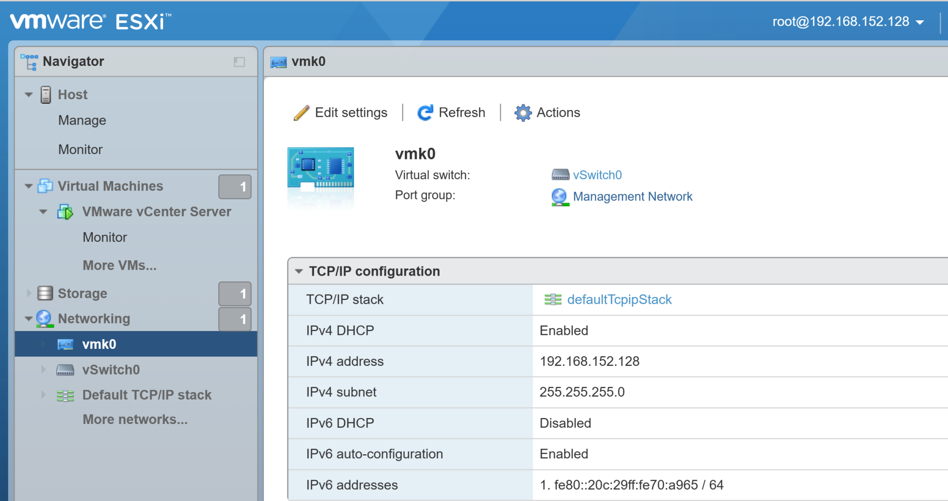
6. Review TCP/IP Configuration

Slide 43
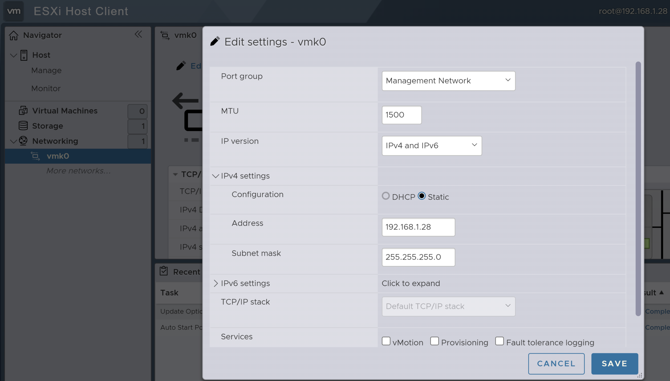
1. Edit Hypervisor IP (vmk0)

Slide 44
Incorrect Static IP Address
If you entered an incorrect static IP address or subnet mask for your ESXi host, the host may become unreachable over the network.
Option 1. Fix directly on the ESXi console if you have physical or remote console access, e.g. iDRAC.
Option 2. Change Network connection to Bridged if the IP address is on the same host network.

Slide 45
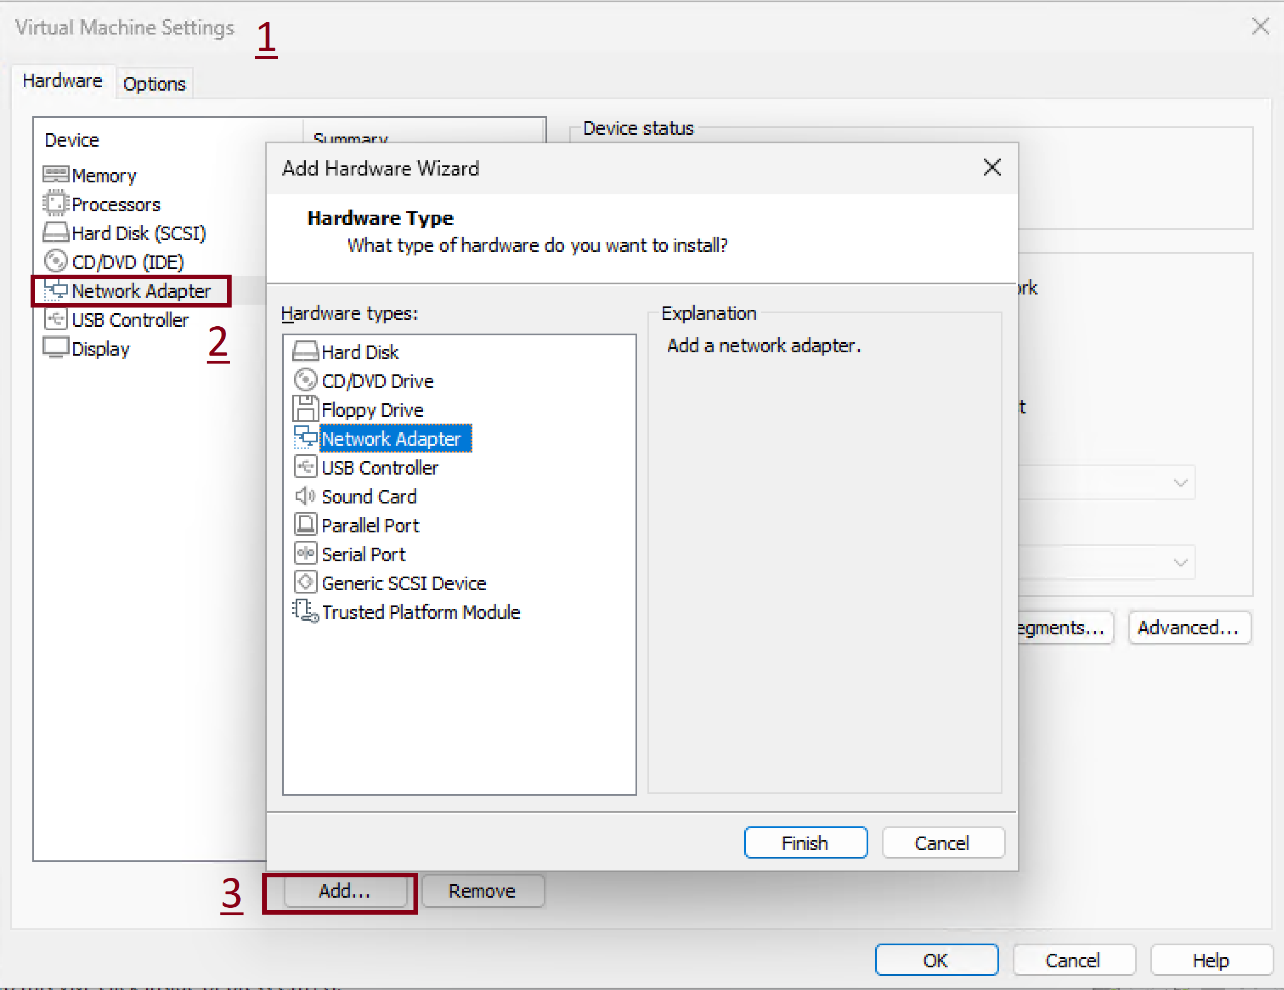
2. Create a New Network Adapter

Slide 47
1. Install VMware Fusion Pro on macOS
https://www.vmware.com/products/desktop-hypervisor/workstation-and-fusion

Slide 48
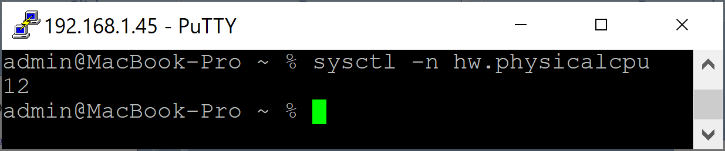
2. Check cores on macOS
# Check the number of physical cores on macOS.
sysctl -n hw.physicalcpu
# Check the number of logical cores on macOS.
sysctl -n hw.logicalcpu

Slide 49
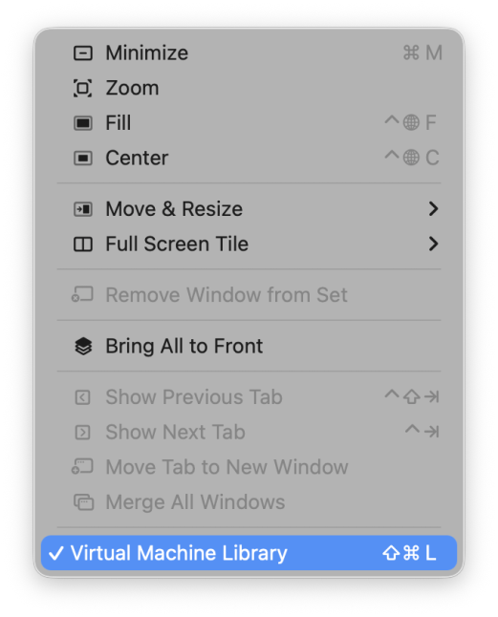
3. View Fusion Virtual Machines
Windows > Virtual Machine Library

Slide 50
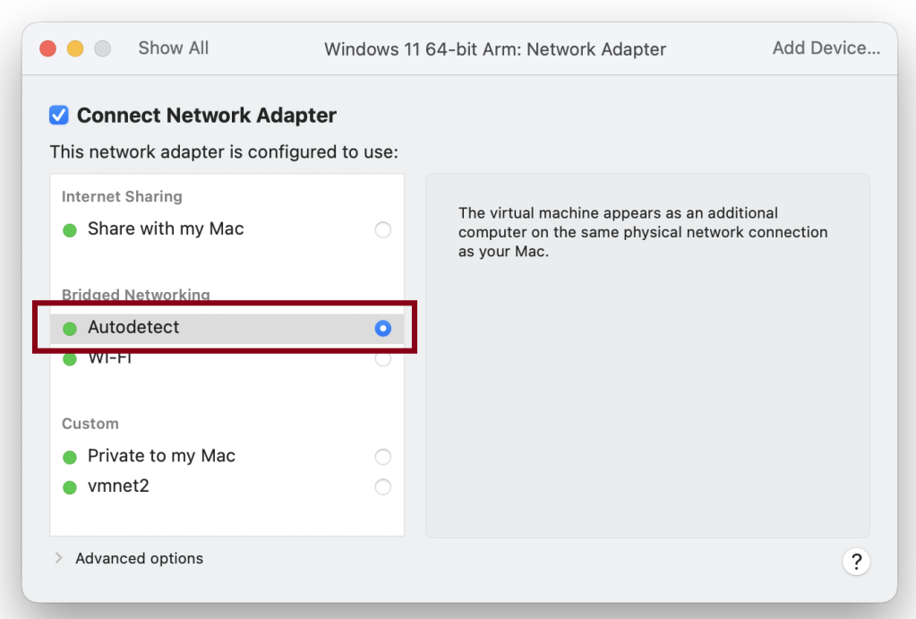
4. Give Virtual Machine a Separate IP in the LAN
The automatically allocated IP will be on the same LAN of the host machine.

Slide 52
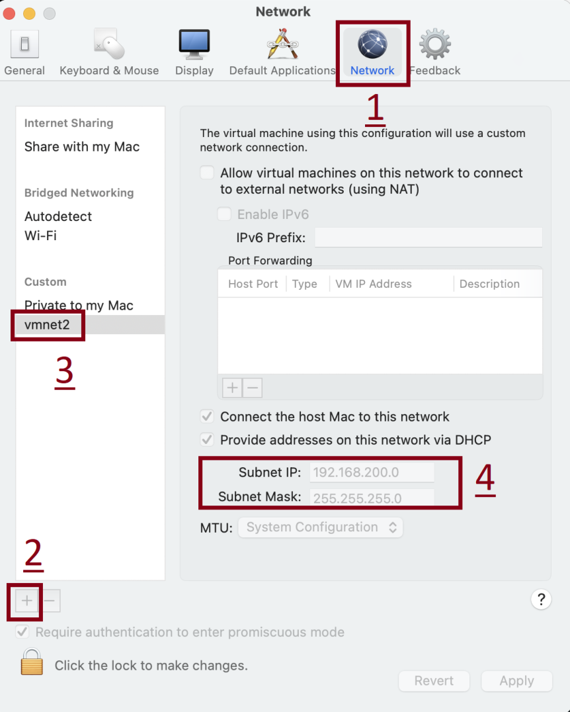
1. Create a Virtual Network
Purpose: Use a separate LAN network for the virtual machines while still allowing them to access the Internet.
MTU (Maximum Transmission Unit) is the largest size of a single data packet, in bytes, that can be transmitted over a network interface without fragmentation.
Subnet: 192.168.200.0
Subnet Mask: 255.255.255.0
VMs get automatic IPs like 192.168.200.128+

Slide 53
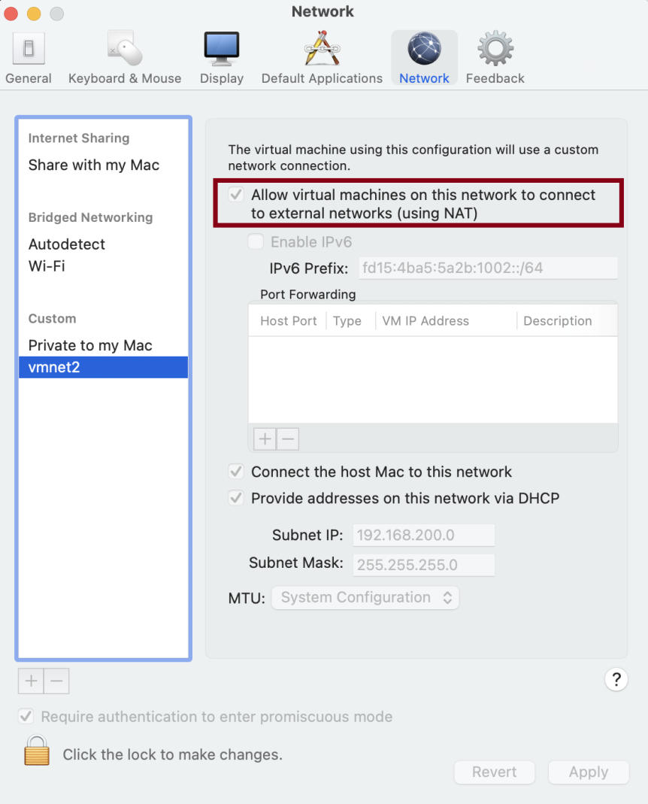
2. Enable Internet Connections for the Virtual Network

Slide 54
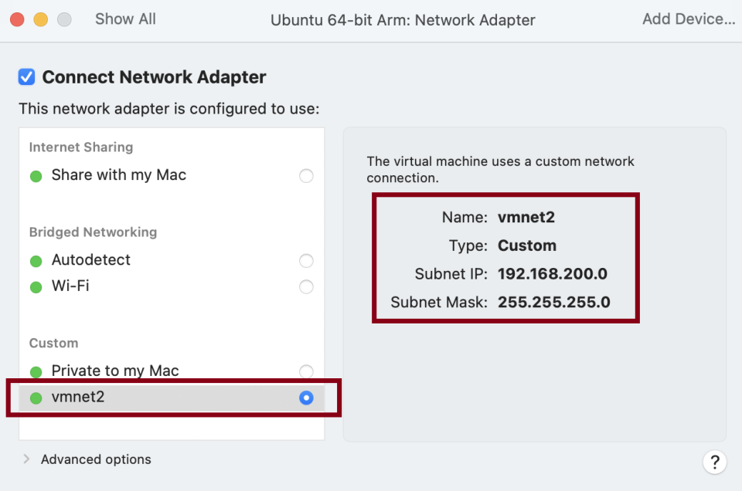
3. Configure Network Adapter for Virtual Machine with Ubuntu
Purpose: To allow the VM with Ubuntu to connect with the VM with Windows 11. See the next slide.

Slide 55
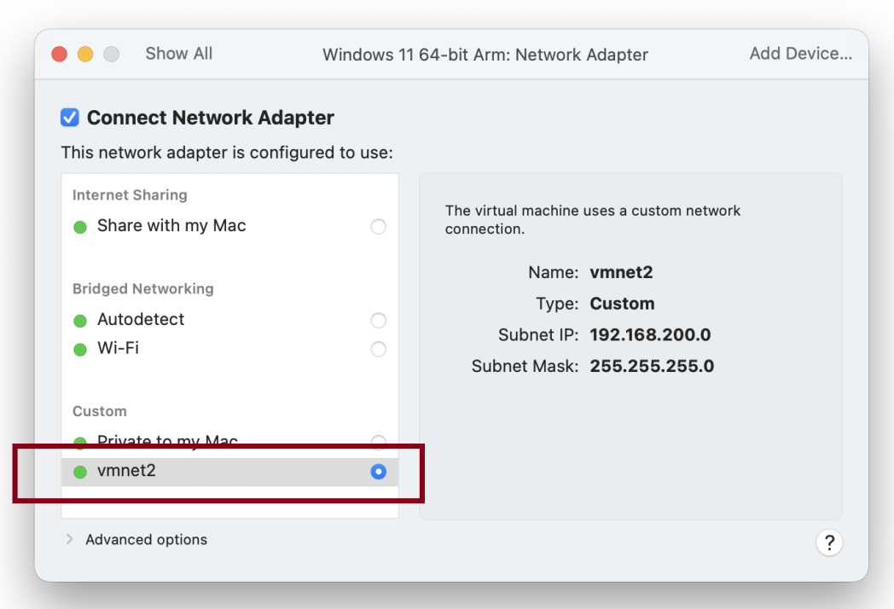
4. Configure Network Adapter for Virtual Machine with Windows 11
Purpose: To allow the VM with Windows to connect with the VM with Ubuntu.

Slide 56
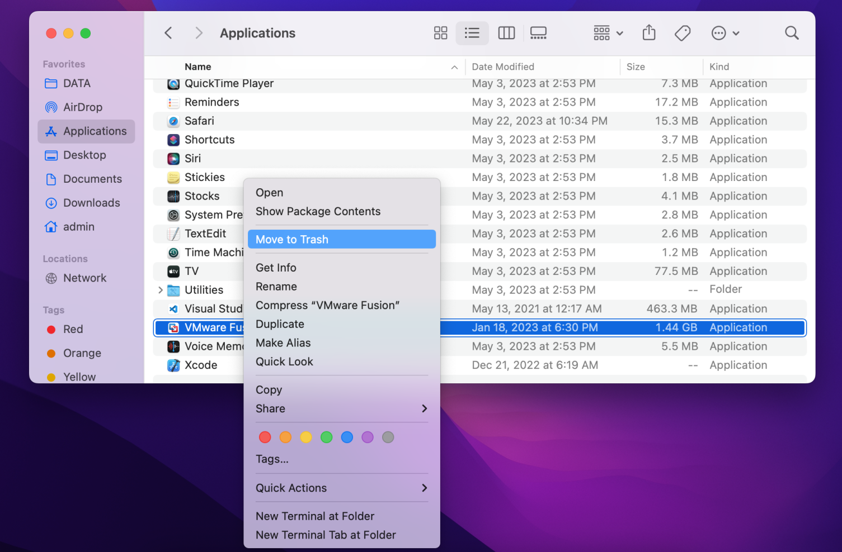
5. Remove VMware Fusion
Go to Applications

Slide 57
6. Remove VMware Fusion Files
sudo rm -rf /Library/Application Support/VMware
sudo rm -rf /Library/Preferences/VMware Fusion
sudo rm -rf ~/Library/Application Support/VMware Fusion
sudo rm -rf ~/Library/Caches/com.vmware.fusion
sudo rm -rf ~/Library/Preferences/VMware Fusion
sudo rm -rf ~/Library/Preferences/com.vmware.fusion.LSSharedFileList.plist
sudo rm -rf ~/Library/Preferences/com.vmware.fusion.LSSharedFileList.plist.lockfile
sudo rm -rf ~/Library/Preferences/com.vmware.fusion.plist
sudo rm -rf ~/Library/Preferences/com.vmware.fusion.plist.lockfile
sudo rm -rf ~/Library/Preferences/com.vmware.fusionDaemon.plist
sudo rm -rf ~/Library/Preferences/com.vmware.fusionDaemon.plist.lockfile
sudo rm -rf ~/Library/Preferences/com.vmware.fusionStartMenu.plist
sudo rm -rf ~/Library/Preferences/com.vmware.fusionStartMenu.plist.lockfile

Slide 59
VMware Cloud Foundation
(VCF) is an integrated software platform that unifies compute, storage, networking, security and management services into a software-defined data centre (SDDC) stack, enabling consistent infrastructure and operations across private, public and edge clouds.

Slide 60
VCF Components
vSphere (ESXi hypervisor + vCenter): server virtualization and compute management
vSAN: software-defined storage integrated with vSphere.
NSX-T: software-defined networking and network security.
vRealize Automation: provisioning and lifecycle management.
vRealize Operations: monitoring and performance analytics.
vRealize Log Insight: log management and analytics.
vRealize Network Insight: advanced network visibility and troubleshooting.
SDDC Manager: orchestrates deployment, configuration, and lifecycle management of the full VCF stack.
Tanzu Kubernetes Grid: for containerized workloads.

Slide 61
Deployment Schema
ESXi hosts are deployed on multiple physical servers.
vCenter is deployed as a VM on an ESXi host (can be HA-enabled with multiple instances)
vSAN is deployed through vCenter by enabling a vSAN cluster on ESXi hosts, which aggregates their local storage into a single distributed datastore managed centrally.
NSX is deployed via vCenter by integrating NSX Manager, which uses vCenter’s inventory to install and configure NSX components across ESXi hosts for virtual networking and security.

Slide 62
VMware Live Recovery
VMware Live Recovery (VLR) is a unified VMware solution that enables both disaster‑recovery and ransomware‑resilient recovery of virtualized workloads using isolated, validated restore points.
VMware Live Recovery is deployed as separate appliances that integrate with vCenter to manage and protect VMs, but it is not installed within vCenter itself.

Slide 63

Thank You & See You Again

